Slide 1
Embedded System Design
LIAO Yong

Slide 2
Case Analysis: Use DARTS to Design a
S/W System of Robot Controller

Slide 3
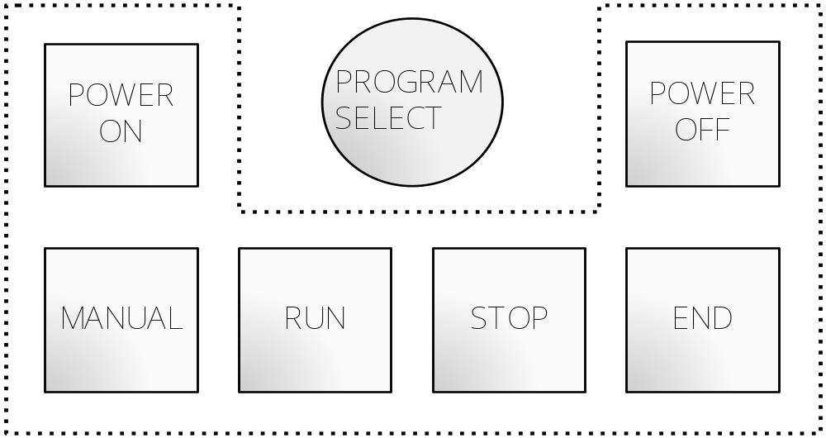
1 Control Panel of Robot Controller
The robot controller controls up to six axes of motion, and interacts with digital I/O sensors
Internal Controller + External Control Panel
Control of axes and I/O is effected by the Internal Controller
External Control Panel = Push buttons+ selector switch

Slide 4
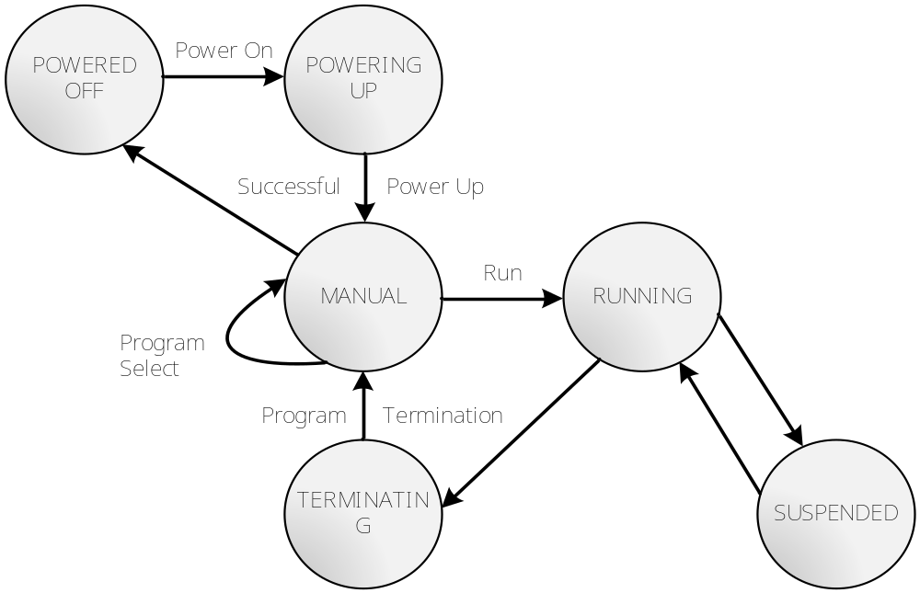
2 State Transfer

Slide 5
3 Data Flow Diagram (DFD)
PROGRAM
Push Buttons
READ
PANEL
Input
  Sensor Value
READ
SONSORS
INTERPRET
PROGRAM
Panel Input
Run，
Star，
End
I/O
Command
Sensor Input
VALIDATE
PANEL
INPUT
Valid Panel Inputs
PROCESS
PANEL
INPUT
PROCESS
I/O COM
Motion
COM
Sensor Output
PROCESS
MOTION
COM
Motion
ACK
Output
Panel Output
Run，
Stop，
Resume
OUTPUT
TO SONSORS
Lights
Motion Block
OUTPUT
TO PANEL
RECEIVE
ACK
OUTPUT
AXIS DATA
Axis Block
Axis ACK
AXIS
CONTROLL
Axis Input
Axis Output

Slide 6

4 Task Decomposition
I/O
PROGRAM
Push Buttons
READ
PANEL
Input
READ
SONSORS
INTERPRET
PROGRAM
  Sensor Value
Panel Input
Run，
Star，
End
I/O
Command
Sensor Input
VALIDATE
PANEL
INPUT
Function cohesion
PROCESS
PANEL
INPUT
Motion
COM
PROCESS
I/O COM
Valid Panel Inputs
PROCESS
MOTION
COM
Sensor Output
Time cohesion
Output
Run，
Stop，
Resume
Motion
ACK
OUTPUT
TO SONSOR
Panel Output
Motion Block
Lights
OUTPUT
TO PANEL
OUTPUT
AXIS
DATA
RECEIVE
ACK
Time cohesion
Axis Block
Axis ACK
Time-Critical
AXIS
CONTROLL
Axis Input
Axis Output

Slide 7
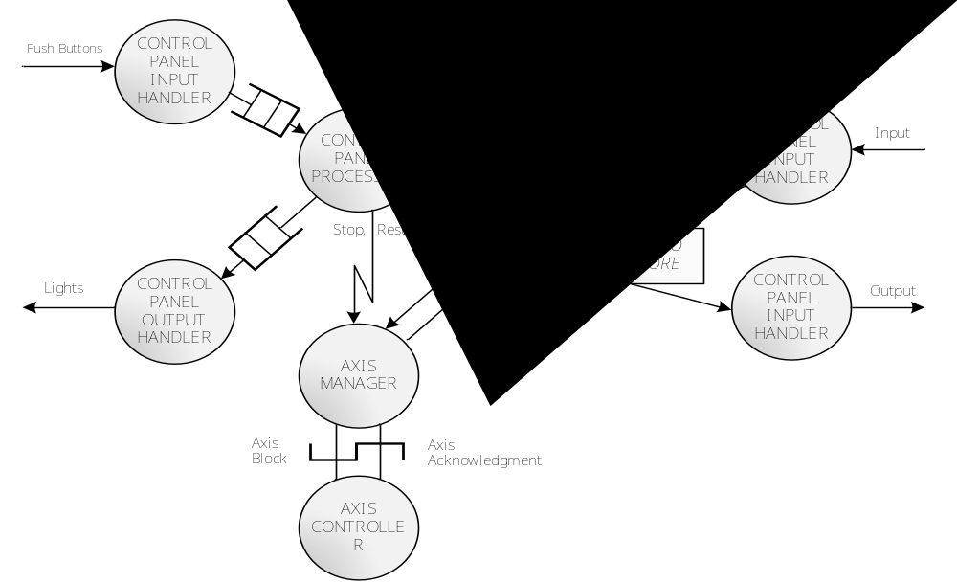
5 Task Structure

Slide 8
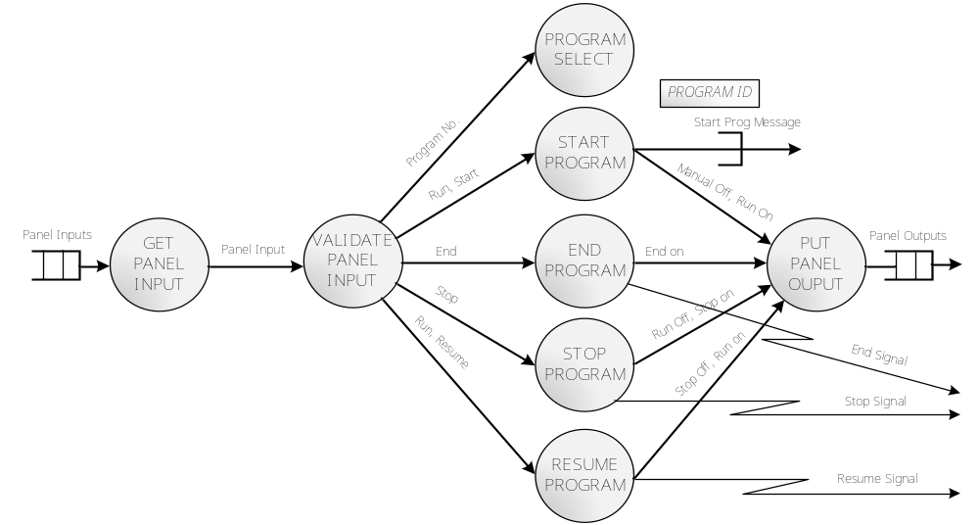
6 Task Design

Slide 9
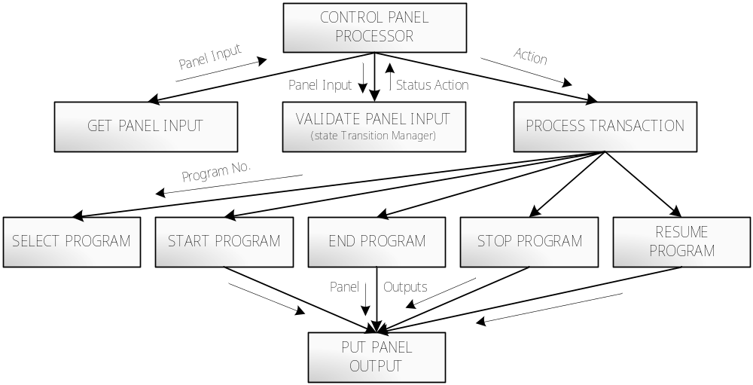
6 Module Design

Slide 10
Criteria for task Decomposition
Purpose of task decomposition
    Identify the parallel functions according to the DFD
    Determine the concurrent tasks
What’s the criteria of task decomposition ?
    Dependence on I/O
    Time-critical functions
    Computational requirements
    Functional cohesion
    Temporal cohesion
    Periodic execution
How to apply the criteria in the robot controller design

Slide 11
I/O Task
App/Task
Device

Slide 12
event 1
Task 1
deadline 1
event 2
Task 2
deadline 2
Task 3
Task 3

Slide 13
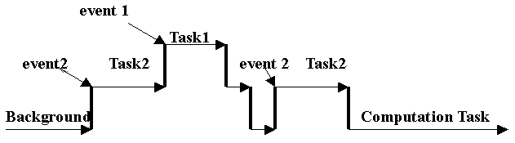

Slide 14
event 1
event 2
F1(x) + F3(x)
F2(x)

Slide 15
event
Clock Tick
F1(x) + F2(y)+F3(z)
F4(x)+F5(y)

Slide 16
10HZ
10HZ
15HZ
15HZ
F2
F2
F1
F1

Slide 17
Definition of task interfaces
TCM (Task Communication Module)
  Message Communication Module (MCM)
    Closely coupled
    Loosely coupled
  Information Hiding Module (IHM)
TSM (Task Synchronization Module)

